Slide 1

Six Task Types for Talking Maths Together
Talking Maths Together: a mentoring toolkit for primary and secondary mathematics
Use these tasks with ITT and ECT colleagues and also with whole mathematics teams. They support a deep focus on core mathematical ideas KS1 to KS4 and contribute to the development of pedagogical intelligence in the teaching of mathematics.
Mentoring is at the heart of developing teaching mathematics

Slide 2
Participants of this Working Group
Ruth Barnett
Kosser Choudry
Matthew Coatsworth
Lucy Dasgupta
Michelle Guy
Linda Hull
Jenni Ingram
Usman Nasir
Louise Price
Jo Skelton
Anne Watson
Andrea Wickham
This document was produced by a BBO Hub NCETM-funded working group of teacher education tutors and mentors from primary and secondary programmes working together, trialling tasks and feeding back experiences.

Slide 3
Contents
Contents
i ii iii iv | Why and how? Six task types and six conceptual threads Mentor-novice pedagogy Background | Why and how? Six task types and six conceptual threads Mentor-novice pedagogy Background | Why and how? Six task types and six conceptual threads Mentor-novice pedagogy Background | Why and how? Six task types and six conceptual threads Mentor-novice pedagogy Background
 | Task type | Content focus | Version | Version
1 | Focus on mathematical thinking | Measurement | Light | Deep
2 | Filling in a concept-pedagogy table | Place value | Light | Deep
3 | Watching an online lesson video -the teaching intentions | Fractions – part/whole relationships | Light | Deep
4 | Sorting components and connections in a conceptual thread | Spatial reasoning | Light | Deep
5 | Thinking about structure by comparing meanings and representations | Multiplication | Light | Deep
6 | What opportunities to learn does this exercise offer? | Algebra | Light | Deep

Slide 4
i Why and how?
The role of mentor is to enable novices [1] to enrich their teaching of mathematics and develop attitudes to professional learning that will continue during their career.
Many mentors have only a little time to engage novices deeply in pedagogical mathematical knowledge, that is knowledge about how their teaching contributes to learners’ mathematical thinking and conceptual progression.
It is often possible to find, or create, six occasions during the training years, one-to-one, or small group, or with colleagues or a whole department, for a long-term focus on conceptual perspectives of mathematics teaching.
We have developed six task types that support this deeper focus. For maximum flexibility each task type comes in two forms: Light version (yellow) and Deep version (green). Tasks also provide suggestions for discussion.
The tasks can be positioned throughout the school year, whatever your programme is like, and can be used with any mathematical content. We present them with specific content to illustrate their richness in supporting novices and mentors to discuss subject knowledge in depth, and so have chosen six conceptual threads that permeate school mathematics. But mathematical content can be chosen, and tasks adapted, to be appropriate to whatever the novice is currently teaching.
We also provide some supplementary examples for those who decide to do this kind of work more than six times.
This booklet does not replace reading and other PD presentations, but lays the foundations for critical, shared, professional learning. However, it is by working with a mentor that novice teachers make sense of ideas, offered by others, in their own practice. They also learn about the depth of thinking about concepts that is part of professional practice. These tasks can be used whatever the methods in the working context might be, because the focus is on mathematics.
For daily issues of planning, teaching and assessment of mathematics we recommend that mentors should also use the mathematics-specific questions and prompts produced by East Midlands Hubs. Click here for primary, here for secondary.
[1] We use the term ‘novices’ throughout as the work of mentoring might begin before, and continue after, the official ITT and ECT phases: the word ‘trainee’ is not adequate for continued professional learning.

Slide 5
ii Six task types and six conceptual threads
Task type | Content | Our reasons
Focus on mathematical thinking | Measurement as a concept: its links with other concepts throughout the curriculum | Mathematical thinking should be embedded in all mathematics lessons. The task enables the conversations that mentor-novice can have about what this means.
Filling in a concept-pedagogy table | Place value as fundamental in our number system: what needs to be understood and why this often goes wrong | Different aspects of a concept need different pedagogical decisions. The task enables conversations about essential details of a concept, common misconceptions, and novices’ own knowledge of these in the curriculum.
Watching online lesson video: the teaching intentions | Fractions: the underlying part/whole relationship | The task of watching and discussing an online lesson exposes the ways in which teachers create a coherent conceptual pathway through a lesson.
Sorting components and connections in a cluster of concepts | Spatial reasoning | The task of sorting the ways in which spatial reasoning contributes to learning mathematics, explicitly and implicitly, gives insights into connections within school mathematics.
Comparing representations to meanings of a core concept | Multiplication | The task reveals how different representations can extend, or limit, learning a concept – therefore how important the choice and use of representations is in teaching.
Working through an exercise to see structure | Algebra | The task gives experience in analysing exercises to uncover the underlying structures in their design and imagine how learners would see that structure.

Slide 6
iii Mentor-novice pedagogy
We find that many tasks often work best when mentors hold back from ‘telling’ and instead ask ‘what else ….?’
Also, there are key questions to bear in mind in discussions around the tasks, and return to frequently:
  What is mathematics?
  What is doing mathematics like?
  What is learning mathematics like?
  Therefore, what can mathematics teaching be like?
  Therefore, what does the culture of the classroom need to be like?
Discussions might sometimes reveal novices’ own confusions or assumptions, and these might be then passed on to learners. In all our tasks it is worth reminding novices of the differences between:
  Everyday meanings
  Previously learnt meanings
  Mathematically useful meanings
  Meanings that need more precision
Further guidance on mentor-novice pedagogy can be found in Questions and Prompts for primary/secondary trainees from East Midlands Hubs.

Slide 7
iv Background
Our task types focus on mathematics content and concepts, the mathematical knowledge relevant for teaching,
The Core Content Framework [2] and the Early Career Framework [3] both emphasise that becoming a teacher develops through guidance from expert colleagues and research, and through practice with feedback from experienced colleagues. But this is not only a matter of following someone else’s rules and guidelines. For ongoing professionalism novices need to experience how their own mathematical thinking can lead to a coherent approach to mathematical content and have the awareness to continue this in their future teaching lives.
Nearly all school learners can and should learn mathematics well, within a broad meaning for ‘mastery’ that sees familiarity, flexibility and fluency with mathematical concepts as a progression of ever more complex ideas, often as threads of meaning throughout the curriculum. The National Curriculum for England (NC) has three interwoven aims: fluency with fundamental concepts and methods; mathematical reasoning; and solving routine and non-routine problems. Some people who come into teaching mathematics have limited experience of some or all three of these aims in their own education. The National Centre for Excellence in the Teaching of Mathematics (NCETM) has identified five Big Ideas towards the aim of mastery for all: Coherence; Representation and Structure; Mathematical Thinking; Variation; Fluency[4]. These ideas are explained on their website and are also addressed in courses run by the MathsHubs network.
[2] https://www.gov.uk/government/publications/initial-teacher-training-itt-core-content-framework
[3] https://www.google.com/search?client=firefox-b-d&q=early+career+framework+2021
[4] https://www.ncetm.org.uk/teaching-for-mastery

Slide 8
1 Task type: Focus on mathematical thinking
Content focus: Measurement
[2] https://www.gov.uk/government/publications/initial-teacher-training-itt-core-content-framework
[3] https://www.google.com/search?client=firefox-b-d&q=early+career+framework+2021
[4] https://www.ncetm.org.uk/teaching-for-mastery

Slide 9
1a
Task type: Focus on mathematical thinking
Content focus: Measurement
Light version: The focus of this task is embedding mathematical thinking into the teaching of mathematical content. The context we use is measurement. The use of repeated units connects to measurement across the curriculum. Measurement relates to place value (via the metric system) and multiplicative relationships such as ratio, proportion, fractions. There is more about this in the longer version of this task. This short version focuses more on the kinds of thinking involved [5]. Ideas that can be removed for primary novices are coloured mauve.
Task – organise your time so that you can consider parts a and b
Part a (measurement)
Core | Extension
How could you measure the length of a table if you only had a bag of matching plastic forks? | How would you describe the shape and size of a table if you only had a bag of matching plastic forks?
How could you measure the stickiness of golden syrup, smooth peanut butter and mayonnaise? | Can you invent a formal definition of stickiness?
How could you measure the length of a moving freight train from a bridge? | How could you measure the length of a moving freight train from a drone moving above the same track?
[5] See also: https://www.ncetm.org.uk/classroom-resources/secmm-mathematical-prompts-for-deeper-thinking-videos/

Slide 10
1b
Task type: Focus on mathematical thinking
Content focus: Measurement
Part b (reflections on mathematical thinking)
Circle the kinds of thinking you used to answer the questions above. Add any more that occur to you.
imagine
rough diagrams
compare
convince yourself
give an example
conjecture
use past knowledge
express to someone else
generalise
test
convince someone else
use a special case
keep something the same so you can change something else
How did using these ways of thinking help you to think about measurement?
All these, and more, are aspects of mathematical thinking that can be used in every lesson.
[6] https://www.atm.org.uk/shop/thinkers-book/act057

Slide 11
1
What is mathematical thinking?
Mathematical thinking is not merely thinking about mathematics, or doing the thinking that depends mainly on memory. It means using mental actions that are mathematical in nature and purpose throughout maths lessons and mathematical work, and learning when it is appropriate to undertake them. This set of related ways to think is helpful.
Organise Organise things into groups, matching items, patterns or orders | Classify Name groups, sets and subsets; distinguish between what is and what is not; describe the comparisons underlying an order
Imagine Imagine objects, values, spatial relationships, effects of actions, static and dynamic situations | Express Show and explain their thinking; use words, diagrams, algebra, graphical representations to show actions, connections and relations
Specialise Look at individual examples, or small sets of examples, or specially chosen examples, extreme examples and non-examples | Generalise Identify relationships and connections and state these as generalities, such as rules or theorems
Conjecture Say what they or suspect about what happens, or what might happen | Convince Persuade others about their conjecture by demonstration, prediction, explanation and proof
Adapted from Mason, J and Johnston-Wilder, S (2004) Learners Powers in : Fundamental Constructs in Education, London: Routledge Falmer pp115-142

Slide 12
1b
Task type: Focus on mathematical thinking
Content focus: Measurement
We recommend that novices compile a repertoire of universal question types that prompt mathematical thinking such as those found in ‘Thinkers’ [6].
Give an example of ... and another example, ... and an example that is different in some way
What was the hardest and easiest of these questions, and why?
Compare and contract these three ...
What is the same and what is different?
What changes and what stays the same?
Is this always, sometimes or never true?
What is the odd one out and why?
Can you make up an expression that 'hides' a particular mathematical structure?
Now you know this, what else do you know?
Are you sure?
[6] https://www.atm.org.uk/shop/thinkers-book/act057

Slide 13
1a
Task type: Focus on mathematical thinking
Content focus: Measurement
Deep version: The focus of this task is the nature of mathematical thinking. In this long version of task 1 we encourage novices to think about how engaging learners in deeper thinking aids learning about the underlying concept. The context we use is measurement across mathematics. The use of repeated units connects to measurement across the curriculum. Measurement relates to place value (via the metric system) and multiplicative relationships such as ratio, proportion, similarity. Questions that can be removed for primary are coloured mauve.
Task – organise your time so that you can consider reflections on measurement and reflections on mathematical thinking
Part a (measurement)
Core | Extension
How could you measure the length of a table if you only had a bag of matching plastic forks? | How would you describe the shape and size of a table if you only had a bag of matching plastic forks?
How could you measure the volume of a lump of playdough? | Could you find the volume of a lump of playdough by weighing it?
What would you need to measure the height of a tree that you know is 10 metres away? | How would that change if you found out that the tree is actually 9 metres away?
How could you measure the stickiness of golden syrup, smooth peanut butter and mayonnaise? | Can you invent a formal definition of stickiness?
How could you measure the length of a moving freight train from a bridge? | How could you measure the length of a moving freight train from a drone moving above the same track?

Slide 14
1a
Task type: Focus on mathematical thinking
Content focus: Measurement
Part a: Reflections on measurement
What is the same or different about the methods you have thought about?
What is the same or different about the measurements you end up with?
What is special about each of the questions?
What are the common features of the above uses of the verb ‘measure’?
Discussion points about measurement
All these measurement questions involve multiplication, because measurement involves ratio (so much per so much)
All involve the use of repeated units, whether these are conventional or not, e.g. forklengths, linear measure, cubic measure etc.
Some involve compound units: stickiness might be in teaspoonfuls dropping over time (other ways of deciding to measure stickiness are possible).
Several involve comparisons: forklengths by forklengths; freight trucks per second for several seconds; similar triangles for adapting the tree question …
What is the substance or quality being measured?
How are >, <, = experienced?
Is there a zero and what is its meaning? (e.g. in temperature zero does not mean an absence if temperature)
What are the basic units that are iterated to quantify the quality? How are they measured? How do they relate directly to the quality being measured?
How are differences in measurement compared? (distance between; less/more than; ‘times as much as’)
Getting a sense of number and quantity: 100m; light years; a kilo of ….

Slide 15
1b
Task type: Focus on mathematical thinking
Content focus: Measurement
Part b (reflections on mathematical thinking)
Circle the kinds of thinking you used to answer the questions above. Add any more that occur to you.
imagine
rough diagrams
compare
convince yourself
give an example
conjecture
use past knowledge
express to someone else
generalise
test
convince someone else
use a special case
keep something the same so you can change something else
A widely used way to understand the processes of mathematical thinking is to see them as the thinking powers that we all have naturally and encourage learners to use them frequently and explicitly in mathematics teaching.
Compare and contrast to identify sameness and differences
Using special examples to explore, make conjectures and testing them
Find something that is generally true, and express it somehow
Convince yourself, and others, about what you have found

Slide 16
1b
Task type: Focus on mathematical thinking
Content focus: Measurement
All these, and more, are aspects of mathematical thinking that can be used in every lesson [7]. We recommend that novices compile a repertoire of universally question types that prompt mathematical thinking such as those found in ‘Thinkers’ [8]. Some of these are below and you will notice that we have already used some in this task. What was their effect on your thinking about measurement?
Give an example of ... and another example, ... and an example that is different in some way
What was the hardest and easiest of these questions, and why?
Compare and contract these three ...
What is the same and what is different?
What changes and what stays the same?
Is this always, sometimes or never true?
What is the odd one out and why?
Can you make up an expression that 'hides' a particular mathematical structure?
Now you know this, what else do you know?
Are you sure?
[7] https://www.ncetm.org.uk/classroom-resources/secmm-mathematical-prompts-for-deeper-thinking-videos/
[8] https://www.atm.org.uk/shop/thinkers-book/act057

Slide 17
1
What is mathematical thinking?
Mathematical thinking is not merely thinking about mathematics, or doing the thinking that depends mainly on memory. It means using mental actions that are mathematical in nature and purpose throughout maths lessons and mathematical work, and learning when it is appropriate to undertake them. This set of related ways to think is helpful.
Organise Organise things into groups, matching items, patterns or orders | Classify Name groups, sets and subsets; distinguish between what is and what is not; describe the comparisons underlying an order
Imagine Imagine objects, values, spatial relationships, effects of actions, static and dynamic situations | Express Show and explain their thinking; use words, diagrams, algebra, graphical representations to show actions, connections and relations
Specialise Look at individual examples, or small sets of examples, or specially chosen examples, extreme examples and non-examples | Generalise Identify relationships and connections and state these as generalities, such as rules or theorems
Conjecture Say what they or suspect about what happens, or what might happen | Convince Persuade others about their conjecture by demonstration, prediction, explanation and proof
Adapted from Mason, J and Johnston-Wilder, S (2004) Learners Powers in : Fundamental Constructs in Education, London: Routledge Falmer pp115-142

Slide 18
2 Task type: Filling in a concept-pedagogy table
Content focus: Place value in the number system
[2] https://www.gov.uk/government/publications/initial-teacher-training-itt-core-content-framework
[3] https://www.google.com/search?client=firefox-b-d&q=early+career+framework+2021
[4] https://www.ncetm.org.uk/teaching-for-mastery

Slide 19
2
Task type: Filling in a concept-pedagogy table
Content focus: Place value in the number system
Light version: This task focuses on connections between different aspects of a concept, and how the links might be made through images, materials, notation and language. The table is given to the novice by the mentor. If you want to use this task type with another content focus the table needs to be created before the session as the detail of a concept is unlikely to be generated by a novice teacher, but we strongly recommend using the place value focus as it can be a basis for many difficulties in future mathematical learning, such as problems with decimal understanding in KS2/3 and beyond. Examples of this kind of task using the foci of angles, inequality, covariation and equivalence can be found in the file: ITT Mentoring Toolkit user reports and adaptations.
Having actual manipulatives to hand would be helpful, or use pictures found here.
Task: What can go into the blank cells? Make notes about what is easy or difficult about filling the cells. Discuss these with your mentor. Find out how these issues are dealt with in the scheme used in your school. Mauve cells that can be removed for primary.
Concept/ context | Materials/ manipulatives | Language | Mental images/ diagrams | Notation | Understanding
Value of digits | Place value arrow cards | Hearing and reading the values: 302 is ‘three hundreds, no tens and two ones’. ‘tenths’. Define and use consistently: digit is one symbol; number is the quantity or value you are representing using numerals that are made up of digits. |  | Numerals in a particular order; over 1000 digits are grouped in threes; in maths exam notation groups of three are separated by commas in the UK. | ‘digit’ v ‘number’ ‘tenths’ etc. relate to fractions. Value of each place. Meaning of decimal point.
Counting in tens, hundreds etc. | Base ten apparatus, PV counters, measures, calculator displays | Emphasis on the first digit, plus its value. How decomposition is expressed, e.g. exchange | Repeated use of digits 0 to 9. The action of exchange

Slide 20
2
Task type: Filling in a concept-pedagogy table
Content focus: Place value in the number system
Concept/ context | Materials/ manipulatives | Language | Mental images/ diagrams | Notation | Understanding
Powers of ten | Base ten apparatus, PV chart, PV counters, numberline | Reading digits with meaning; how decimal values are read, or often omitted (e.g. 0.435 read as ‘zero point 4 3 5) Reading very small and very large numbers. | Symbols in columns, PV charts, zoom images of numberline |  | Cyclic nature of counting to 9 in every ‘place’. Multiplying and dividing by powers of 10. What digits to the right of the point mean. Rate of growth. Standard form. Rounding.
Zero as placeholder in whole numbers | Base ten apparatus, PV columns, PV chart, PV arrow cards |  |  |  | Roles of zero. Approximation as ‘how close’
Number expresses quantity |  | Discuss <, >, = and changes, e.g. adding on, repeating units, growth | Measures: spatial, mass, time, dimensions, exponential growth | Units of measurement; common notations | Dimensionality, approximation ‘how close’, relative sizes (ratio), > and < and =
Negative numbers | Rare real contexts: thermometers, car park levels. ‘distance between’ gives meaning to subtraction. | ‘negative 3’ rather than ‘minus 3’ |  |  | An abstract and logical idea; reasoning with negative numbers depends on understanding that the negative of a negative must be a positive.
x and ÷ by powers of ten and then x and ÷ decimal numbers | Measuring devices and base ten manipulatives | Describe the outcome of mult/div a number by ten etc. | PV columns, pictures of growth, scaling, zoom images. | Is it the digits or the decimal places that ‘move’? | That ‘shortcuts’ moving the decimal point obscure important meanings about the value of each digit.
Decimals | Base ten apparatus, PV chart, decimals, tape measures, 100 squares, money | How decimal digits are read and their meaning. The ‘th’ in tenths! Compare 3.24 with £3.24 | PV columns, zoom images. Money. |  | x10 and ÷10 etc. Number in science and other measures. Role of zero. £3.24 and 3.24
Logarithms; standard form | Calculators, scaling; logarithmic scales; powers of ten | Standard notation: how to read it | Zoom images; Examples of use­­­­­ | Common notation in text and on calculators

Slide 21
Concept/ context | Materials/ manipulatives | Language | Mental images/ diagrams | Notation | Understanding
Value of digits | Place value arrow cards | Hearing and reading the values: 302 is ‘three hundreds, no tens and two ones’. ‘tenths’. Define and use consistently: digit is one symbol; number is the quantity or value you are representing using numerals that are made up of digits. |  | Numerals in a particular order; over 1000 digits are grouped in threes; in maths exam notation groups of three are separated by commas in the UK. | ‘digit’ v ‘number’ ‘tenths’ etc. relate to fractions. Value of each place. Meaning of decimal point.
Counting in tens, hundreds etc. | Base ten apparatus, PV counters, measures, calculator displays | Emphasis on the first digit, plus its value. How decomposition is expressed, e.g. exchange | Repeated use of digits 0 to 9. The action of exchange
Powers of ten | Base ten apparatus, PV chart, PV counters, numberline | Reading digits with meaning; how decimal values are read, or often omitted (e.g. 0.435 read as ‘zero point 4 3 5) Reading very small and very large numbers. | Symbols in columns, PV charts, zoom images of numberline |  | Cyclic nature of counting to 9 in every ‘place’. Multiplying and dividing by powers of 10. What digits to the right of the point mean. Rate of growth. Standard form. Rounding.
Zero as placeholder in whole numbers | Base ten apparatus, PV columns, PV chart, PV arrow cards |  |  |  | Roles of zero. Approximation as ‘how close’
Number expresses quantity |  | Discuss <, >, = and changes, e.g. adding on, repeating units, growth | Measures: spatial, mass, time, dimensions, exponential growth | Units of measurement; common notations | Dimensionality, approximation ‘how close’, relative sizes (ratio), > and < and =
Negative numbers | Rare real contexts: thermometers, car park levels. ‘distance between’ gives meaning to subtraction. | ‘negative 3’ rather than ‘minus 3’ |  |  | An abstract and logical idea; reasoning with negative numbers depends on understanding that the negative of a negative must be a positive.
x and ÷ by powers of ten and then x and ÷ decimal numbers | Measuring devices and base ten manipulatives | Describe the outcome of mult/div a number by ten etc. | PV columns, pictures of growth, scaling, zoom images. | Is it the digits or the decimal places that ‘move’? | That ‘shortcuts’ moving the decimal point obscure important meanings about the value of each digit.
Decimals | Base ten apparatus, PV chart, decimats, tape measures, 100 squares, money | How decimal digits are read and their meaning. The ‘th’ in tenths! Compare 3.24 with £3.24 | PV columns, zoom images. Money. |  | x10 and ÷10 etc. Number in science and other measures. Role of zero. £3.24 and 3.24
Logarithms; standard form | Calculators, scaling; logarithmic scales; powers of ten | Standard notation: how to read it | Zoom images; Examples of use­­­­­ | Common notation in text and on calculators

Slide 22
2
Task type: Filling in a concept-pedagogy table
Content focus: Place value in the number system
Discussion points about place value
Place value lurks in learners’ understandings of money, metric quantity, notation, numberline, decimals, measurement and powers. Novice teachers may be unaware of the connections and common features of these ideas, including the importance of ‘ten’.
Listen to how we talk about the digits after the decimal point in money, numberline, measurement – can language choices emphasise the value of each digit (including zero)?
  May say ‘units’ instead of ‘ones’
  May say 0.43 as ‘nought point forty-three’
  May name digits instead of value in whole number column arithmetic
Novice teachers might have depended on shortcuts such as ‘move the decimal point’ or ‘round up from the right’ (e.g. rounding 3.645 to one decimal place and arriving at 3.7 via 3.65).
When rounding, what is the role of zero?
A very common misconception is that the longer the decimal part, the bigger the number, e.g. 3.215 > 3.4
Sources for learning about common misconceptions

Slide 23
2
Task type: Filling in a concept-pedagogy table
Content focus: Place value in the number system
Deep version (for extended mentoring session, groupwork, homework, department workshop)
Provide a pile of materials typically used to teach or use place value. Use pictures of materials you might not have to hand, see here.
Task: Have copies of the empty table below. Start with a row that is immediately relevant for current teaching. Using the materials as starters for discussion, consider each cell to connect materials, language associated with materials, probably image arising from materials and language, notation and (therefore) understanding. Then move to the row above, or another earlier row that is a prerequisite for the row you have chosen. If you have time, go also to later rows. Alternatively, novices can share the row work with others and report back. Cells that can be removed for primary novices are coloured mauve.
If you want to use this task type with another content focus the table needs to be created before the session as the detail of a concept is unlikely to be generated by a novice teacher, but we strongly recommend using the place value focus as it can be a basis for many difficulties in future mathematical learning, such as problems with decimal understanding in KS2/3 and beyond.
Examples of this kind of task using the foci of angles, inequality, covariation and equivalence can be found in the file: ITT Mentoring Toolkit user reports and adaptations.

Slide 24
Concept/ context | Materials/ manipulatives | Language | Mental images/ diagrams | Notation | Understanding
Value of digits
Counting in tens, hundreds etc.
Powers of ten
Zero as placeholder in whole numbers
Number expresses quantity
Negative numbers
x and ÷ by powers of ten and then x and ÷ decimal numbers
Decimals
Logarithms; standard form

Slide 25
Here is a filled table using our experience as mentors/tutors, work with novices and also drawing on research. Other versions are possible of course.
Concept/ context | Materials/ manipulatives | Language | Mental images/ diagrams | Notation | Understanding
Value of digits | Place value arrow cards | Hearing and reading the values: 302 is ‘three hundreds, no tens and two ones’. ‘tenths’. Define and use consistently: digit is one symbol; number is the quantity or value you are representing using numerals that are made up of digits. | Written numerals. Groupings of objects, e.g. bundles of straws | Numerals in a particular order; over 1000 digits are grouped in threes; in maths exam notation groups of three are separated by commas in the UK. | ‘digit’ v ‘number’ ‘tenths’ etc. relate to fractions. Value of each place. Meaning of decimal point.
Counting in tens, hundreds etc. | Base ten apparatus, PV counters, measures, calculator displays | Emphasis on the first digit, plus its value. How decomposition is expressed, e.g. exchange | Repeated use of digits 0 to 9. The action of exchange
Powers of ten | Base ten apparatus, PV chart, PV counters, numberline | Reading digits with meaning; how decimal values are read, or often omitted (e.g. 0.435 read as ‘zero point 4 3 5) Reading very small and very large numbers. | Symbols in columns, PV charts, zoom images of numberline | Meaning of the decimal point. Very large and very small numbers. Measures | Cyclic nature of counting to 9 in every ‘place’. Multiplying and dividing by powers of 10. What digits to the right of the point mean. Rate of growth. Standard form. Rounding.
Zero as placeholder in whole numbers | Base ten apparatus, PV columns, PV chart, PV arrow cards | When and how zero is read, or not read. | PV columns | When and how zero is used | Roles of zero. Approximation as ‘how close’
Number expresses quantity | ‘stuff’ and usual measuring devices | Discuss <, >, = and changes, e.g. adding on, repeating units, growth | Measures: spatial, mass, time, dimensions, exponential growth | Units of measurement; common notations | Dimensionality, approximation ‘how close’, relative sizes (ratio), > and < and =
Negative numbers | Rare real contexts: thermometers, car park levels. ‘distance between’ gives meaning to subtraction. | ‘negative 3’ rather than ‘minus 3’ | Numberline beyond zero; symmetry around zero; double-sided counters | Use of this sign ‘-‘. The apparent ‘reversal’ of the order of the numerals. | An abstract and logical idea; reasoning with negative numbers depends on understanding that the negative of a negative must be a positive.
x and ÷ by powers of ten and then x and ÷ decimal numbers | Measuring devices and base ten manipulatives | Describe the outcome of mult/div a number by ten etc. | PV columns, pictures of growth, scaling, zoom images. | Is it the digits or the decimal places that ‘move’? | That ‘shortcuts’ moving the decimal point obscure important meanings about the value of each digit.
Decimals | Base ten apparatus, PV chart, decimats, tape measures, 100 squares, money | How decimal digits are read and their meaning. The ‘th’ in tenths! Compare 3.24 with £3.24 | PV columns, zoom images. Money. | Role of zero in decimal places. | x10 and ÷10 etc. Number in science and other measures. Role of zero. £3.24 and 3.24
Logarithms; standard form | Calculators, scaling; logarithmic scales; powers of ten | Standard notation: how to read it | Zoom images; Examples of use­­­­­ | Common notation in text and on calculators

Slide 26
2
Task type: Filling in a concept-pedagogy table
Content focus: Place value in the number system
Novices’ awareness of learners’ place value understanding can often lead to problems, so we include here some details advice for recognising when and how to discuss precise meanings with them. Examples of this kind of task using the foci of angles, inequality, covariation and equivalence can be found in the file: ITT Mentoring Toolkit user reports and adaptations.
Novice teacher understandings | Further work with novice teachers
May be unaware of the meaning of ‘place value’ and unaware of any possible problems. May say ‘units’ instead of ‘ones’ May say 0.43 as ‘nought point forty-three. | Value depends on place. What is a digit? What is a number? Possible intro to place value chart <link> and its use. Relate to familiar linear measure. Forty-three means four tens and three ones. (In some cultures, it is OK to say ‘nought point 43’ as pupils have learnt to think ‘43 hundredths’; this is a potential confusion with money where £0.43 means ’43 pence’)
Not knowing the importance of 10. | Questions arising from using the place value chart <link> Use Dienes/base10 apparatus themselves as a separate experience from preparation to teach to get a ‘feel’ for how it supports understanding; identify typical difficulties by listening to learners chanting counts
Not knowing the importance of base 10. Own inner speech has shortcuts. Column methods can lead to digits being named instead of their value being understood. Role of zero when rounding to sig. fig. or nearest ten. | ‘What if?’ work in different bases (2 (binary),60 (time), 12. Connect use of materials to language. Get novices to say numbers out loud, compare different ways of saying them and identify whether these ways have numerical meaning. Can they round 2.45 correctly to the nearest whole number? (i.e. not by rounding to 2.5 and thence to 3 and similar examples.)
Own knowledge of positional value of decimals; Assumptions about obviousness of place value. Role of zero when rounding to sig. fig. or nearest whole number | Connect symbols to language. Carry out small group ‘research’ with a few learners and observe what they do/say etc.
Shortcuts that have limited value; moving decimal point; adding a zero etc. | Relate the change in position to the multiplication or division that has been done.
Use of number to mean ‘digit’. | Define and use consistently: digit is one symbol; numeral is the written symbolic representation of a number; number is the enumeration you are representing using numerals that are made up of digits.
Using a comma to separate large numbers v. using a space (as in science). Using a dot as the decimal separator v. using a comma (as in other countries) | Show the testing regime; be aware of correct writing of numbers that is judged incorrect by the current regime. Be aware of novice teachers whose schooling was in other cultures.

Slide 27
3 Task type: Watching online lessons: teaching intentions
Content focus: Fractions: part/whole relationships
[2] https://www.gov.uk/government/publications/initial-teacher-training-itt-core-content-framework
[3] https://www.google.com/search?client=firefox-b-d&q=early+career+framework+2021
[4] https://www.ncetm.org.uk/teaching-for-mastery

Slide 28
3
Task type: Watching an online lesson video - the teaching intentions
Content focus: Fractions - part/whole relationships
Find a suitable video of a teacher presenting an online prepared lesson with no pupils. We used NCETM and Oak National Academy as free sources that were produced for use during Covid lockdown.
This video addresses the ideas of ‘whole’ and ‘part’ as an introduction to fractions for KS2
This video addresses related ideas for KS3: Equal parts of a whole.
If you are working at KS4 you might also use a video that uses algebraic fractions.
V
Light version. Before the mentoring session: watch an online lesson and try to reconstruct the teacher-thinking that might have gone on behind it. Make notes about the following questions.
Makes notes about:
Having watched this lesson, what was the content?
What might the learners have seen? Heard? Done? Connected? Thought about?
What does the lesson assume about prior mathematical knowledge and ways of working with mathematics?
Describe the development of the mathematical idea through different stages of the lesson
How has the teacher constructed the development of the content through the learners’ experience?
Selection and sequence of examples (what and how …?) Use of materials (what and how were materials used?) Representations (what and how …?) Use of images (what and how …? Use of language (what and how …?)

Slide 29
3
Task type: Watching an online lesson video - the teaching intentions
Content focus: Fractions - part/whole relationships
In the mentor session, follow up with the following probing questions:
Notes | Probing
Teacher’s intentions: Having watched this lesson, what was the content? | What were the intentions of the teacher and how do you know?
Learners’ experience: What might the learners have seen? Heard? Done? Connected? Thought about? | What do you think learners would remember from this lesson? What evidence are you using? How might learners’ experience of the lesson compare to the teacher’s intentions? Avoid being judgemental as you do not know the rest of the lesson sequence.
What does the lesson assume about prior mathematical knowledge and ways of working with mathematics? | How were these used in the development of the concept or mathematical ways of working?
Describe the development of the mathematical idea through different stages of the lesson? | Was this development through practice, or conceptual thinking or a mixture of both?
How has the teacher constructed the development of the content through the learners’ experience? | How were these different elements connected as a mathematical idea?
Follow up with specific questions about elements that have not been mentioned: Selection and sequence of examples (what and how …?) Use of materials (what and how were materials used?) Representations (what and how …?) Use of images (what and how …? Use of language (what and how …?) | What might you take forward into your teaching as a result of analysing this video?
Although the point of this task is to alert novices to the care they need to take when designing, selecting and using examples, representations, materials, images and language in their own teaching, this is also a useful task for probing their own mathematical knowledge. Differences of perspective might depend on the novice having thin, fragile or superficial understandings of the concepts being taught so this exercise provides an opportunity for these to be explored and deepened in a situation.

Slide 30
3
Task type: Watching an online lesson video - the teaching intentions
Content focus: Fractions - part/whole relationships
Find a suitable video of a teacher presenting an online prepared lesson with no pupils. We used NCETM and Oak National Academy as free sources that were produced for use during Covid lockdown.
This video addresses the ideas of ‘whole’ and ‘part’ as an introduction to fractions for KS2
This video addresses related ideas for KS3: Equal parts of a whole.
If you are working at KS4 you might also find a video that uses algebraic fractions.
Deep version. Watch the lesson video together.
It can be stopped at any point to discuss the following issues. It is very easy to fall into criticism of other people’s lessons without knowing the surrounding lesson sequence. The point of this task is to imagine the lesson from the learners’ point of view and imagine how this relates to the teaching intentions. From this experience, novice teachers are more likely to plan by imagining several dimensions of the learners’ experience. We have chosen fractions as the focus but this task could be done with any focus that is currently relevant for the novice. However, the KS2 lesson is an example of how everyday understandings can be used as a way into a core idea about the mathematical concept.
  Everyday meanings
  Previously learnt meanings
  Mathematically useful meanings
  Meanings that need more precision

Slide 31
3
Task type: Watching an online lesson video - the teaching intentions
Content focus: Fractions - part/whole relationships
An important shift that learners make in KS2 is that the relationship of part to whole in fractions is NOT the additive relation that younger children will have experienced, so there has to be a shift of understanding, while retaining their understanding of the additive ‘part-part-whole’ relationship which has been understood early in their school learning. Comparing a part to the whole leads to an understanding of unit fractions. Then the denominator tells us for the kind of diagrams and images they may have had. the size of a part and the numerator tells us how many of those unit parts we have. Younger learners will have had experience of part-part-whole additive relationships, see here.
During the session, the following aspects could be discussed. Questions for mentors to pose to novices (each can be followed up with ‘what else?’)
Initial questions to find out what has been observed | Probing
Teacher’s intentions: Having watched this lesson, what was the content? | What were the intentions of the teacher and how do you know?
Learners’ experience: What might the learners have seen? Heard? Done? Connected? Thought about? | What do you think learners would remember from this lesson? What evidence are you using? How might learners’ experience of the lesson compare to the teacher’s intentions? Avoid being judgemental as you do not know the rest of the lesson sequence.
What does the lesson assume about prior mathematical knowledge and ways of working with mathematics? | How were these used in the development of the concept or mathematical ways of working?
Describe the development of the mathematical idea through different stages of the lesson? | Was this development through practice, or conceptual thinking or a mixture of both?
How has the teacher constructed the development of the content through the learners’ experience? | How were these different elements connected as a mathematical idea?
Follow up with specific questions about elements that have not been mentioned: Selection and sequence of examples (what and how …?) Use of materials (what and how were materials used?) Representations (what and how …?) Use of images (what and how …? Use of language (what and how …?) | What might you take forward into your teaching as a result of analysing this video?
Ask the novice teacher how the elements connect to make it likely that learners will understand the concept being taught. Are there any loose ends, non-sequiturs, assumptions about familiarity, obscure words or expressions? Although the point of this task is to alert novices to the care they need to take when designing, selecting and using examples, representations, materials, images and language in their own teaching, this is also a useful task for probing their own mathematical knowledge. Differences of perspective might depend on the novice having thin, fragile or superficial understandings of the concepts being taught so this exercise provides an opportunity for these to be explored and deepened in a situation.

Slide 32
3
Task type: Watching an online lesson video - the teaching intentions
Content focus: Fractions - part/whole relationships
Relating the video to the novice’s own thinking
The connections between teacher’s intentions, teacher’s actions and what the learner might perceive are the focus, but inevitably discussion will tip over into ‘what might you do?’ ‘What might you do differently?’ and the mentor maybe suggesting alternatives. Mentoring can be directive, advisory or educational and it depends on individual novices and their development of pedagogical intelligence[9] how much direction or advice is necessary.
What do you think? | What might you do?
Choosing a particular slide or episode: What part did this play in the development of learning in the lesson? | How would you support this learning if you were in the classroom? Would you spend more/less time on this and why?
About the lesson overall: How was the intended learning supported appropriately? Did you the relevance of each part for learning the intended concept? | What might you want to know about the teacher’s thinking? What might you do more of/less of/differently and why? What might the previous lesson have been about?
In a live lesson, teaching can respond and adapt to learners’ work. Where would you like to have had feedback from learners in this lesson? | In a live lesson using this material, are there any critical moments where you might expect to have to slow down or maybe speed up? What is your reasoning for this?
What next? | How might you consolidate, extend or apply learning after this?
What provision has been made for learners with poor reading skills? | How could this lesson be made appropriate for learners with language and sensual limitations? What might you do differently after seeing this lesson?
What might you remember/take away from each learning experience. Why did you remember these points? What, in the teaching, supported you in noticing and remembering these? What did you already know that helped you follow the lessons? What mathematical questions arose for you? What gaps, if any, did you notice in your own knowledge that made you feel uneasy
The reasons for reflecting on their own learning reactions to a lesson include giving you access to monitoring their own mathematical knowledge; thinking about the small conceptual components that support mathematical learning; understanding how attention and memory can be managed in lessons.
Reflecting on their own experiences of attention and memory can be a more effective method to learn about how teachers manage these aspects of teaching than merely being told to use a particular tactic.
[9] Rubin, L. (1989). The thinking teacher: Cultivating pedagogical intelligence. Journal of teacher education, 40(6), 31-34.

Slide 33
4 Task type: Sorting components and connections of a concept thread
Content focus: Spatial reasoning
[2] https://www.gov.uk/government/publications/initial-teacher-training-itt-core-content-framework
[3] https://www.google.com/search?client=firefox-b-d&q=early+career+framework+2021
[4] https://www.ncetm.org.uk/teaching-for-mastery

Slide 34
4
Task type: Sorting components and connections of a concept thread
Content focus: Spatial reasoning
We use the phrase ‘spatial reasoning’ to include a wide range of mathematical contexts in which visualising space helps understanding by providing static or dynamic images or metaphors, even if the contexts do not come under the usual curriculum headings of ‘geometry and measures’. Spatial reasoning follows from many pre-school and everyday experiences in addition to what is learnt formally.[10]
Light version: The task uses sorting and connecting to expand the idea of spatial reasoning across the curriculum. There are 12 cards.
Highlight the features on each card that relate to the phase you are teaching and focus on these features. You can ignore any that don’t mean much to you yet and maybe come back to them later.
Then sort the cards according to the relationships you see between the aspects of spatial reasoning that you have highlighted. Have blank cards for adding new features, or duplicating features.
This card set has been produced from research, curriculum and from mentors’ experience of novices’ understandings.
Note that learners’ understanding of angles can be problematic. We provide a supplementary task here.
[10] https://earlymaths.org/spatial-reasoning and Spatial-Reasoning-Document-new.pdf 2.85 MB View full-size Download

Slide 35
4
Task type: Sorting components and connections of a concept thread
Content focus: Spatial reasoning
Position and direction: forward/backward; left/right; clockwise/anticlockwise; inside; between; relatively; perspective; vector; orientation; close to; middle of | Movement: distance to and from and between; close to; speed; twice as/half as far; spiral; turn; up/down; climb/slide; way-finding; Scratch programming | Transforming shapes; transformations on coordinate grids; conservation; similarity; congruence; rotate, reflect, translate objects, 2D and 3D
Lines; numberline; vectors; parallel lines; perpendicular lines; angles and parallel lines; axes; straight lines; graphs of data; graphs of algebraic functions | Comparisons: sizes, measurements: length, area, volume, capacity,; enlargement/(shrinking), Perimeter, area, surface area, volume of compound shapes. | Full/empty; filling up/emptying out; liquids in 3D containers; ‘seeing’ fractions of and proportions
Pattern spotting/seeking/construction; repetition (ABBABBA etc.); tessellation; images of infinity; Escher | Composing; fitting together; taking apart; nesting and containing; folding; matching; symmetry; nets; compound shapes and objects | Shapes: 2Dand 3D, names of shapes; names of parts of shapes; properties of their angles, edges, diagonals, faces, cross-sections. Circles.
Drawing; constructing; imagining; scaling (zooming in/out); scale drawings; elevations and nets. Spatial features of graphs that represent data. Making rough diagrams to indicate any mathematical relationship | Reasoning from properties; theorems involving properties of squares, rectangles, triangles; angles in circles; angles and parallel lines | Angles: what they are; right angles; fractions of full turns; measuring; angles in polygons; theorems and right-angled triangles; trigonometry.

Slide 36
4
Task type: Sorting components and connections of a concept thread
Content focus: Spatial reasoning
Discussion points about spatial reasoning Spatial reasoning is more than the facts, identifying, naming, symmetries and measures that appear as ‘shape and space’ in some schemes of work and ‘geometry and measurement’ in the curriculum. Spatial reasoning relates to all the items in the cards and more. E.g. Ask people to close their eyes and point to where ‘zero’ is on their mental numberline, and then where 100 is, and then where 10000 is. Most people have some mental image. Find out what spatial representations novices have that they use for numerical, graphical, statistical and other aspects of mathematics. Think about ways of using and developing learners’ natural spatial reasoning to enrich their learning of mathematics.
A helpful questioning sequence that opens a wide discussion goes like this:
What do you think ‘spatial reasoning’ refers to?
What are the connections between these? What are the differences?
Is there another way to sort them?
Have any conceptualisations been missed?
What is the difference between spatial reasoning and numerical reasoning? (for secondary this could be extended to probabilistic, statistical and algebraic reasoning).
[10] https://earlymaths.org/spatial-reasoning and Spatial-Reasoning-Document-new.pdf 2.85 MB View full-size Download

Slide 37
4
Task type: Sorting components and connections of a concept thread
Content focus: Spatial reasoning
We chose ‘spatial reasoning’ as a focus for a card-sorting exercise because it lurks in so many topics across the curriculum.
There was no intention to say that this set is ‘complete’ or that the groupings in each box are the only possible groupings. You might like to make your own that are relevant for particular Key Stages. We use the phrase ‘spatial reasoning’ to include a wide range of mathematical contexts in which visualising space helps understanding by providing static or dynamic images or metaphors, even if the contexts do not come under the usual curriculum headings of ‘geometry and measures’. Spatial reasoning follows from many pre-school and everyday experiences in addition to what is learnt formally.[11]
This card set of 12 has been produced from research, curriculum and from mentors’ experience of novices’ understandings.
Deep version: Choose a card and talk about how it relates to the curriculum of the phase you teach, and how it might relate to earlier and later phases; choose another card and discuss how it could be connected to your first card through the way you teach.
A helpful questioning sequence that opens a wide discussion goes like this:
What do you think ‘spatial reasoning’ refers to?
What are the connections between these? What are the differences?
Is there another way to sort them?
Have any conceptualisations been missed?
What is the difference between spatial reasoning and numerical reasoning? (for secondary this could be extended to probabilistic, statistical and algebraic reasoning).
[11] https://earlymaths.org/spatial-reasoning.

Slide 38
4
Task type: Sorting components and connections of a concept thread
Content focus: Spatial reasoning
Position and direction: forward/backward; left/right; clockwise/anticlockwise; inside; between; relatively; perspective; vector; orientation; close to; middle of | Movement: distance to and from and between; close to; speed; twice as/half as far; spiral; turn; up/down; climb/slide; way-finding; Scratch programming | Transforming shapes; transformations on coordinate grids; conservation; similarity; congruence; rotate, reflect, translate objects, 2D and 3D
Lines; numberline; vectors; parallel lines; perpendicular lines; angles and parallel lines; axes; straight lines; graphs of data; graphs of algebraic functions | Comparisons: sizes, measurements: length, area, volume, capacity,; enlargement/(shrinking), Perimeter, area, surface area, volume of compound shapes. | Full/empty; filling up/emptying out; liquids in 3D containers; ‘seeing’ fractions of and proportions
Pattern spotting/seeking/construction; repetition (ABBABBA etc.); tessellation; images of infinity; Escher | Composing; fitting together; taking apart; nesting and containing; folding; matching; symmetry; nets; compound shapes and objects | Shapes: 2Dand 3D, names of shapes; names of parts of shapes; properties of their angles, edges, diagonals, faces, cross-sections. Circles.
Drawing; constructing; imagining; scaling (zooming in/out); scale drawings; elevations and nets. Spatial features of graphs that represent data. Making rough diagrams to indicate any mathematical relationship | Reasoning from properties; theorems involving properties of squares, rectangles, triangles; angles in circles; angles and parallel lines | Angles: what they are; right angles; fractions of full turns; measuring; angles in polygons; theorems and right-angled triangles; trigonometry.

Slide 39
4
Task type: Sorting components and connections of a concept thread
Content focus: Spatial reasoning
Note that learners’ understanding of angles can be problematic. We provide a supplementary task here.
Discussion points about spatial reasoning Spatial reasoning is more than the facts, identifying, naming, symmetries and measures that appear as ‘shape and space’ in some schemes of work and ‘geometry and measurement’ in the curriculum. Spatial reasoning relates to all the items in the cards and more. E.g. Ask people to close their eyes and point to where ‘zero’ is on their mental numberline, and then where 100 is, and then where 10000 is. Most people have some mental image. Find out what spatial representations novices have that they use for numerical, graphical, statistical and other aspects of mathematics. Think about ways of using and developing learners’ natural spatial reasoning to enrich their learning of mathematics.
Construct tasks for your teaching context that use and develop learners’ natural spatial reasoning to enrich their mathematical thinking, problem solving, and applications of mathematics.

Slide 40
5 Task type: Thinking about structure by comparing meanings and representations
Content focus: Multiplication
[2] https://www.gov.uk/government/publications/initial-teacher-training-itt-core-content-framework
[3] https://www.google.com/search?client=firefox-b-d&q=early+career+framework+2021
[4] https://www.ncetm.org.uk/teaching-for-mastery

Slide 41
5
Task type: Thinking about structure by comparing meanings and representations
Content focus: Multiplication
Multiplication is a central idea throughout school mathematics and beyond. This task brings to the fore how important it is to coordinate images, words, symbols and meanings throughout mathematics. The full card set can be adapted or extended to include more about ratio and rate for secondary teachers and perhaps more about division for primary teachers.
Light version: Sort a phase-relevant subset of the cards into groups that ‘mean the same thing’ and then find, or create, diagrams that express the same meaning. Suggest materials that can be used to express ’the same thing’ for your learners. Make notes about meanings that you were not aware of or do not currently emphasise. How can you help learners to connect different meanings? It would benefit all novices to work with the full set at some stage, since all meanings of ‘multiplication’ have roots and other connections to everyday situations, but cards that can be removed for primary teachers have been coloured mauve below.
The full versions of usable cards is given in editable table format to download, edit and print here. They are also available to view only here. There is also a small set for twos, fives and ten available here.
Discussion points for multiplication What meanings and experiences of multiplicative reasoning would you expect your learners to have before you teach them? What meanings and experiences of multiplicative reasoning would you expect your learners to meet when they progress further through school? How do any representations limit meanings? How do any representations expand meanings? How can fluent multiplication tables support, or detract from, the meanings in the cards? Consider the language you use in multiplicative contexts – how does it support expansion of meanings?

Slide 42
3 lots of 12 | 12 lots of 3
3 times 12 | 12 times 3
3 multiplied by 12 | 12 multiplied by 3
12, 3 times | 3, 12 times
3 (12) | 12 (3)
3 x 12 | 12 x 3
3 times as much as 12 | 12 times as much as 3
Product of 3 and 12 | Product of 12 and 3
3 by 12 | 12 by 3
3 groups of 12 | 12 groups of 3
3⋅12 | 12⋅3
Repeated addition | Allocation or rate

Slide 43
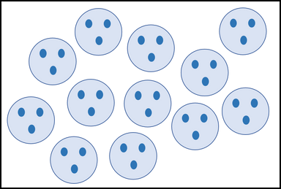

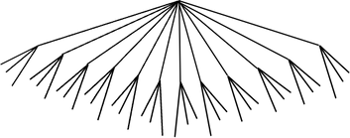
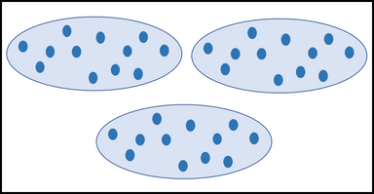
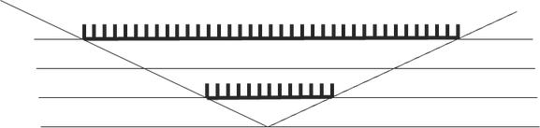
Array or area | Scale factor
Cartesian product
Cakes come in 3 different sizes and any one of 12 different flavours. How many different choices are there?
A cake has 3 chocolate buttons on top. If I have 12 cakes, how many buttons do I have? | A shop sells 12 types of cake. I buy 3 of each type, how many cakes do I buy?
Cakes are arranged on a rectangular plate in 3 rows and 12 columns. How many cakes are there on a plate? | Louise has 12 cakes. Jo has 3 times as many. How many cakes does Jo have?

Slide 44
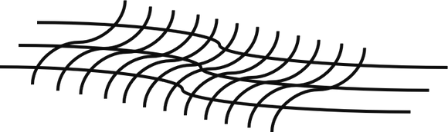
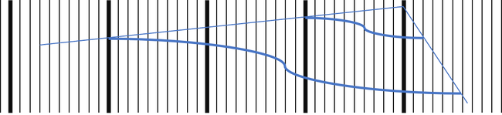

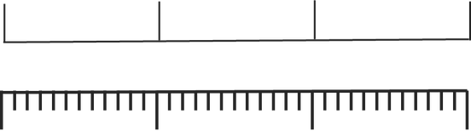

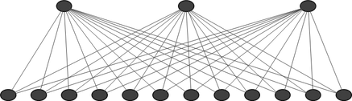
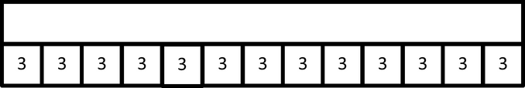
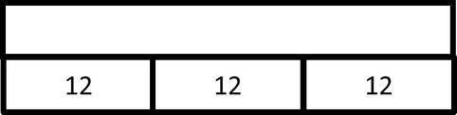


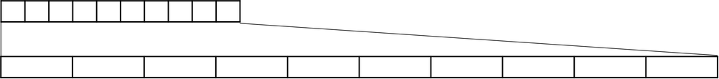

Slide 45
5
Task type: Thinking about structure by comparing meanings and representations
Content focus: Multiplication
Deep version (for longer mentor sessions, ‘homework’, and/or working with groups and colleagues)
This is a card-sorting activity that is similar to the quick version but with additional pedagogical suggestions that could generate deeper engagement and discussion. First sort the first few pages of cards into groups that mean ‘the same thing’. Then the images are included and matched to the groupings, which may have to be reorganised as the task proceeds. Finally introduce the word versions – these illustrate different meanings (e.g. repeated addition, scaling, correspondence) of multiplication and generate discussion about whether some representations (notation and pictorial) are better suited to some meanings than to others. Then novices can find a topic in the NC that might call for multiplication and discuss how they can find out what meanings their pupils would bring to the task. It would benefit all novices to work with the full set at some stage, since all meanings of ‘multiplication’ have roots and other connections to everyday situations, but cards that can be removed for primary teachers have been coloured mauve in the set above.
The full versions of usable cards is given in editable table format to download, edit and print here. They are also available to view only here.
There is also a small set of fives, twos and ten here.
We give details about how these have been used successfully with secondary novices in the file: ITT Mentoring Toolkit user reports and adaptations.

Slide 46
5
Task type: Thinking about structure by comparing meanings and representations
Content focus: Multiplication
Notes on using multiplication cards with groups of secondary novices
I usually print out the cards (on card) and have one set for each group of student teachers (4-6 in a group). The first 4 pages are on one colour, the next two in a different colour, the rest in a third colour.
The cards are initially face down in piles.
Stage 1
To begin with I ask the student teachers to group the cards from the first 4 pages according to whether they have the same meaning or not.
  There is usually someone who will say that they are all the same (because they have the same answer)
  There is usually a debate over whether “3 times 12” is the same as “3 lots of 12” or “12 lots of 3”
  Sometimes someone will also introduce a new way of describing the multiplication, and I invite them to include this on one of the blank cards
  Each group of student teachers usually ends up with a different grouping to the other groups in the room
Stage 2
I then ask them to match visual representations to the cards they have already grouped. I also ask them to make sure that everyone in their group can see how each representation can be a representation of 3x12 as there are usually a few representations they will have not seen before and that they will need to make sense of.
  This matching process usually results in the student making changes to their groupings from Stage 1
  Some groups take some time to notice that it will not be a 1-1 correspondence and again in this situation there is often a rethinking.
  Stage 3
I then ask them to look at the 5th and 6th cards. One set includes some names for different conceptualisations of multiplication and the other set includes some word problems to illustrate this difference. I usually talk through the connections between these word problems and the names and talk through the connections with where children might meet them in the curriculum, and where they might be emphasised in the curriculum.
I then ask them to return to the grouped cards from Stage 2 and ask them identify representations that illustrate a particular conception of multiplicative reasoning, and representations that might represent more than one or even all representations.
Finally, I ask them to consider when the distinctions made might matter for student learning. Can they identify contexts where it is particular important that they are using a scale factor conceptualisation rather than repeated addition conceptualisation for example? Would holding one particular conceptualisation limit what a student understood within another mathematical topic within the curriculum?

Slide 47
6 Task type: What opportunities to learn does this exercise offer?
Content focus: Algebra
[2] https://www.gov.uk/government/publications/initial-teacher-training-itt-core-content-framework
[3] https://www.google.com/search?client=firefox-b-d&q=early+career+framework+2021
[4] https://www.ncetm.org.uk/teaching-for-mastery

Slide 48
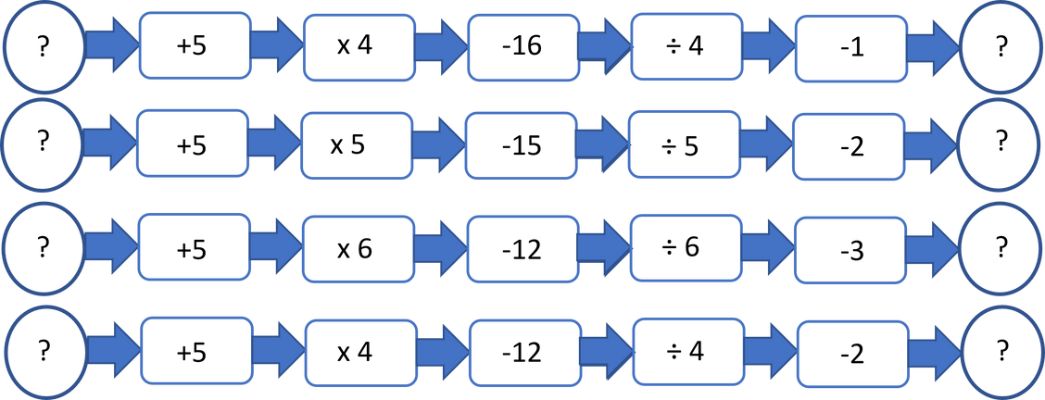
6
Task type: What opportunities to learn does this exercise offer?
Content focus: Algebra
Well-designed exercises often have hidden structural features that engage learners in deeper understanding of the concept being practised. In our view, no exercise should be invented or used without the teacher’s understanding of what can be learnt from it besides repetition of a method using different numbers.
Light version: an exercise with hidden structural features .
Work through the exercise, making notes about features that interest you as you do the task:
What opportunities to learn does this exercise offer?
What opportunities for thinking and discussion among learners does this exercise offer?
What do you think the designer had in mind when they made this exercise?
What ideas from this exercise design can you take forward when selecting or devising exercises in future?

Slide 49
6
Task type: What opportunities to learn does this exercise offer?
Content focus: Algebra
Well-designed exercises often have hidden structural features that engage learners in deeper understanding of the concept being practised. In our view, no exercise should be invented or used without the teacher’s understanding of what can be learnt from it besides repetition of a method using different numbers.
Deep version (for longer mentor sessions, ‘homework’, and/or working with groups and colleagues)
Task a: Work through this exercise, making notes about features that interest you as you do the task:
What opportunities to learn does this exercise offer?
What opportunities for thinking and discussion does this exercise offer?
What do you think the designer had in mind when they made this exercise?
How might the lesson continue if you used this near the beginning?
What ideas from this exercise design can you take forward when selecting or devising exercises in future?

Slide 50
6
Task type: What opportunities to learn does this exercise offer?
Content focus: Algebra
Task b: Now use an early algebra exercise from Don Steward’s website https://donsteward.blogspot.com/ (a rich and imaginative source of tasks for secondary mathematics from year 7 onwards.)
The point of this task is not to rush through and try to do all 24 questions!! Instead, consider what each question offers in terms of learning, and make notes about your experience of doing it. Think about connections between these questions and learners’ experience of arithmetic.
What forms of reasoning and past knowledge are you needing to use? What difficulties do you meet? We learn about our learners’ experience of doing mathematical tasks from our own experience of doing such tasks, as well as from research and advice from expert others. Leave time to tackle the next set of questions.
What ideas from this exercise design can you take forward when selecting or devising exercises in future?
Discussion points for a sequence of algebra questions How could these be read in ways that make the meaning clear? (e.g. ‘I think of a number and ….’) How could these be imagined to make the reasoning possible? (diagrams, bar models, counting) What prior knowledge is necessary? Does this knowledge have to be fluent? Can they make up, and explain, similar tasks for themselves? Given the above: for what purpose would this exercise be helpful: new learning; deeper understanding; speed and accuracy; flexibility; learning the role of the equals sign; learning to ‘read’ (algebraic expressions); practising using trial and adjustment; preparation for the next conceptual step; assessment? How can those whose preferred approach is ‘counting on’ be helped to use structural transformations? Choosing one of these purposes, sort the questions into those that do/do not serve that purpose.

Slide 51
6
Task type: What opportunities to learn does this exercise offer?
Content focus: Algebra
(1)
(2)
(3)
(4)
(5)
(6)
3 +
= 11
– 6 = 24
3
= 21
½
= 15
– 19 = 21
– 8 = – 1
(means 3 × something)
(7)
(8)
(9)
(10)
(11)
(12)
⅓
= 25
11 – = 2½
¾
= 30
2
+ 3 = 17
20 = 2
+ 4
3
+ 1 = 28
(13)
(14)
(15)
(16)
(17)
(18)
31 = 7 + 4
2
+ 1 = 17
9 = 19 – 2
5 + 2 = 8
8 = 9 – 2
5
+ 9 = 54
(19)
(20)
(21)
(22)
(23)
(24)
50 = 54 + 4
⅔
+ 3 = 15
– 5 = 15
4 + 3 =
20 – 3 =
⅝
2
– 1 =
19 – 3
5 +
5 + 2

Slide 52
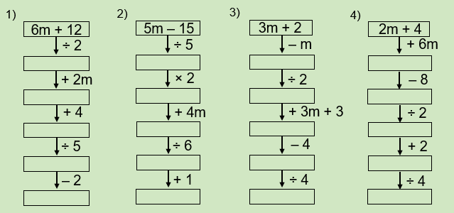
6
Task type: What opportunities to learn does this exercise offer?
Content focus: Algebra
Task c: An exercise that has hidden structural features (we have used part of an early algebra exercise from Don Steward’s website https://donsteward.blogspot.com/
Work through the exercise, making notes about interesting features. Compare this layout to the flow diagrams in the first task.

Slide 53
6
Task type: What opportunities to learn does this exercise offer?
Content focus: Algebra
Discussion points for algebra flow diagrams
  Is this an exercise for learning? For becoming fluent? For discovering structural rules?
  What prior knowledge is necessary? (It may be less than you think if they have images or software to use, e.g. CAS, bar models, pictures of bags variables)
  What variations will be missed if they don’t do all 8?
  What might people discover? How do they use the hidden self-checking device?
  What is being learnt (about working with expressions)?
  Can learners now work in the reverse direction? What ‘rules’ can be derived from this (of inverse actions)?
  Can learners make up some like these themselves?
What ideas from this exercise design can you take forward when selecting or devising exercises in future?

Slide 54
Supplementary Materials
Task | Materials
1 | Working together on a mathematical task to experience mathematical thinking
2 | Place value manipulatives
3 | Part-whole models
4 | Angle sorting task Concept study by comparing resources
5 | Multiplication cards (editable set) Multiplication cards (view only) 2 x 5 cards
6
Further resources can be found at:
  https://www.ncetm.org.uk/classroom-resources/secondary-ite-professional-development-materials/https://www.ncetm.org.uk/classroom-resources/primary-ite-professional-development-materials/

Slide 55
Working together on a mathematical task to extend direct experience of mathematical thinking
New teachers often do not recognise the thinking that they do in mathematical situations as ‘mathematical thinking’. It can be more specific than ‘thinking about mathematics’, or trying to remember what to do in a situation. Making their own constructive thinking explicit helps to make it possible to plan to include it in their teaching, either as an upfront lesson aim or as an embedded part of their teaching through:
  Modelling mathematical thinking in their classroom interactions
  Providing opportunities for learners to do extensive thinking (e.g. problem solving; investigating …)
  Naming aspects of mathematical thinking (e.g. pattern-seeking; conjecturing; using examples; recalling what they know that might be useful …)
  Embedding the need for, and opportunities for, mathematical thinking throughout mathematics lessons (e.g. through dialogue; through generalisation; through convincing each other …)
  Anticipating and supporting the thinking that learners need to do to achieve a particular task, even going down blind alleys.
  Scaffolding sequences typical of mathematical thinking such as: specialise, generalise, conjecture, convince (Mason, Burton, Stacey); what to do when ‘stuck’ (also Mason et al.); helping learners develop mathematical habits of mind (Cuoco, Goldenberg, Mark <link>). See also
  Develop the habit of using prompts such as those in: Thinkers; Questions and Prompts for Mathematical Thinking; Primary Questions and Prompts; It makes you think! (all available from atm.org.uk).
“Mathematical thinking includes
  a. looking for pattern in order to discern structure
  b. looking for relationships and connecting ideas
  c. reasoning logically, explaining, conjecturing and proving.” (NCETM 2020).
  But it is more productive to give novices experiences that require mathematical thinking, rather than merely giving definitions of mathematical thinking.
  Learners’ own mathematical thinking does not develop by treating a list of actions as a learnt order of steps. That is why it is worth giving time for novices to experience and talk about their own thinking when doing mathematics. Ideally, the normal interactions in classrooms could become expressions of mathematical thinking. But first they need to think about their own experiences and then read the NCETM descriptions as reflective notes.

Slide 56
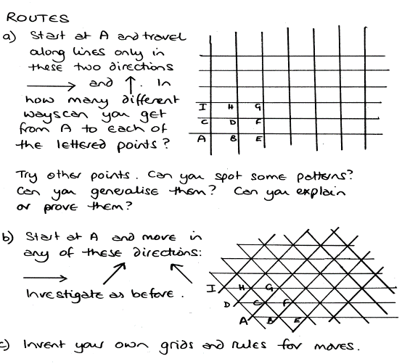
Working together on a mathematical task to extend direct experience of mathematical thinking
Work on a mathematical task
Give a mathematical task for the novice to do, maybe alongside you if it is a task you have not yet worked on; discuss and name what mental actions were undertaken. Here are some tasks that mentors have used successfully:
  https://nrich.maths.org/32 Tea Cups. This task concerns sorting and arranging mixed sets of cups and saucers in different colours. It provides an opportunity for novices to experience solving a problem without a known procedure and then to compare and justify the strategies they developed to find solutions. In that process they can name aspects of mathematical thinking, including issues such as conjecture, certainty, anticipation. It is freestanding with respect to the curriculum so the challenge is then to imagine how similar thinking might be embedded in curriculum topics.
  A secondary provider asks novices to construct a ‘times table’ square in base 12 (under timed conditions). This presents novice teachers with similar constraints and conditions to traditional fast-paced procedural teaching but also provides opportunities to develop pattern seeking, structural shortcuts, ‘if --- then’ arguments, seeking and using similarities between elements (and incidentally becoming fluent through using structure rather than through following given methods). Bases 3 and 4 might be more suitable for primary novice teachers for similar purposes.
  Tasks from intentionally challenging sources having several possible methods of solution, such as UKMT, NRICH, STEP papers, Underground Maths, Thinkers, Thinking for ourselves, It Makes you Think (atm.org.uk)
  Using an open task such as from the ATM series ‘Points of Departure’(atm.org.uk) e.g.

Slide 57
Working together on a mathematical task to extend direct experience of mathematical thinking
B. Compare the thinking
Compare the thinking that has been generated in tasks a,b,c and d. How are these same as or different from each other and from learning to follow and apply a given procedure?
Has the novice’s own thinking been challenged and, if so, how might it be resolved?
Notes about working with novices who are mathematically confident
Recognise that some novice primary teachers might have very little mathematical confidence, so the way you as mentor gets them to work on mathematics could model the kind of thinking that can be done in unfamiliar mathematical situations. Do you push the mathematical content by asking relatively closed questions or making specific suggestions, or do you elicit ideas by questioning and making occasional suggestions about ways to think, e.g. can you explain what you have thought about so far? have you tried an example? Would drawing some kind of diagram help? Is there a simpler problem that would shed some light on this? What mathematical ideas come to mind when you look at this? If so, be explicit about the way you used prompts to support their work.
You may need to decide whether to use a mathematical context that is something they are going to teach soon, in which case their focus might be on children’s learning to do something, or something not immediately necessary, in which case they may be able to focus on how they think rather than what they think.
Recognise that those who are confident mathematically might need to be put into a position of not knowing in order to get some insights into thinking strategies.

Slide 58
Working together on a mathematical task to extend direct experience of mathematical thinking
C. Breaking down what is involved in an advanced task
Ask confident novice teachers to do a challenging task that is within the curriculum appropriate for their future teaching, e.g. for secondary novices ask them to integrate sec2Ɵ with respect to Ɵ. The emphasis is likely to be on ‘what do you do when you don’t know what to do or cannot remember how to do something?’ This involves analysis of the task; collecting knowledge and experiences that might be helpful; sketching a graph; looking for substitutions that might simplify or offer a different route; trying to recall rules and methods for subgoals; applying remembered methods, which may lead to dead ends; deciding what is needed to become unstuck or get out of a dead end; reversed thinking to check by differentiation; collaboration, such as asking someone else a question that might lead to insights; etc. All these strategies can be named and recognised as components of mathematical thinking.
Ideally, novices could observe a teacher who is skilled at generating deep mathematical thinking in their ordinary lessons, rather than a ‘special’ mathematical thinking lesson. Online video resources tend to be ‘special’ in some way.
(Note: https://www.youtube.com/watch?v=mNNVx-Q8Yic is an entertaining and intelligent presentation of a method in which the presenter talks about aspects of his mathematical reasoning in ways that illustrate general features of mathematical thinking.)
For early years, for safeguarding reasons it is hard to find videos of real children doing their reasoning, but this paper gives insight into the many ways in which very young children share objects between three people, having previously shared between 2. https://link.springer.com/article/10.1007/BF00302442
For middle years, you could discuss how you would do a question from KS2 papers that has baffled many learners. Or something like ‘Given that 5542 ÷ 17 = 326, what else do you now know? Can you now know 326 x 18 without multiplying anything? Or 325 x 18?
Links to other materials
See also Secondary ITE professional development materials | NCETM and Primary ITE professional development materials | NCETM (links)
Habits of mind (link)
Habits of Mind for Young Learners (link)

Slide 59
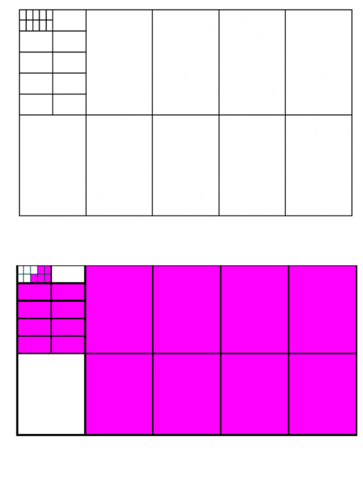
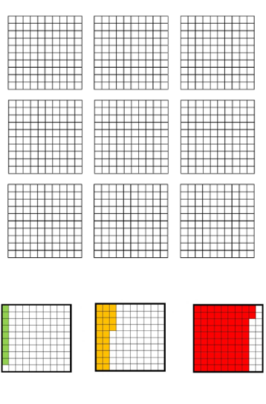
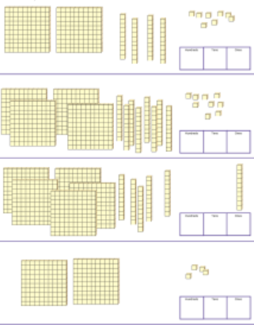
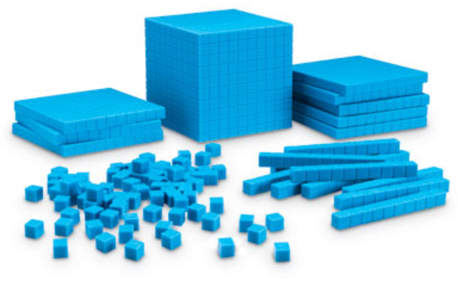
Place value manipulatives and images used frequently in primary mathematics to represent place value meaning and notation

Slide 60
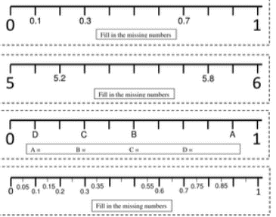
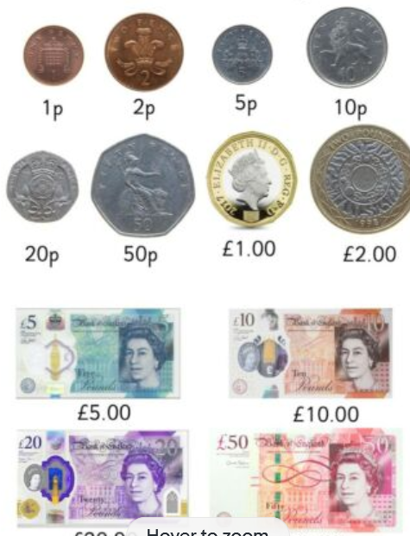

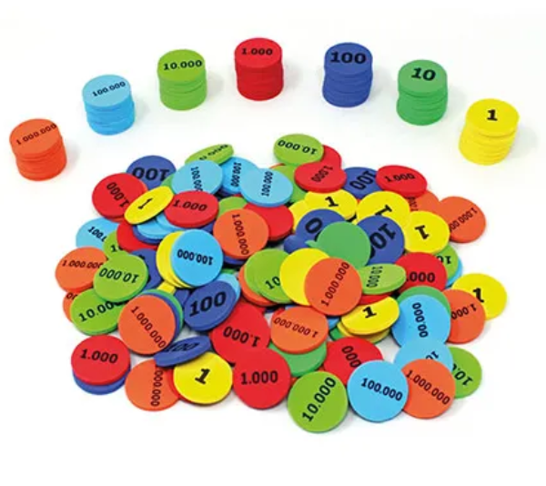
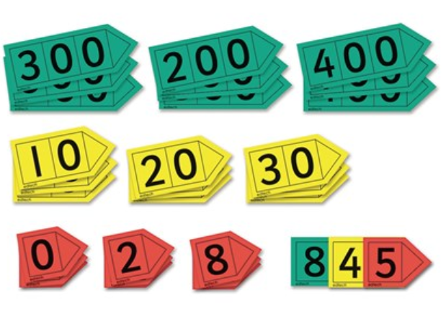
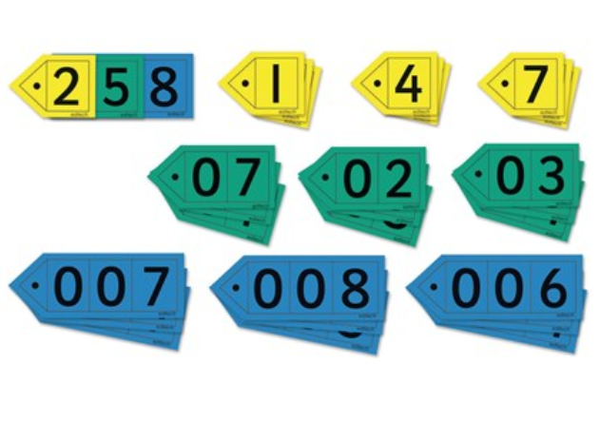
Place value manipulatives and images used frequently in primary mathematics to represent place value meaning and notation

Slide 61
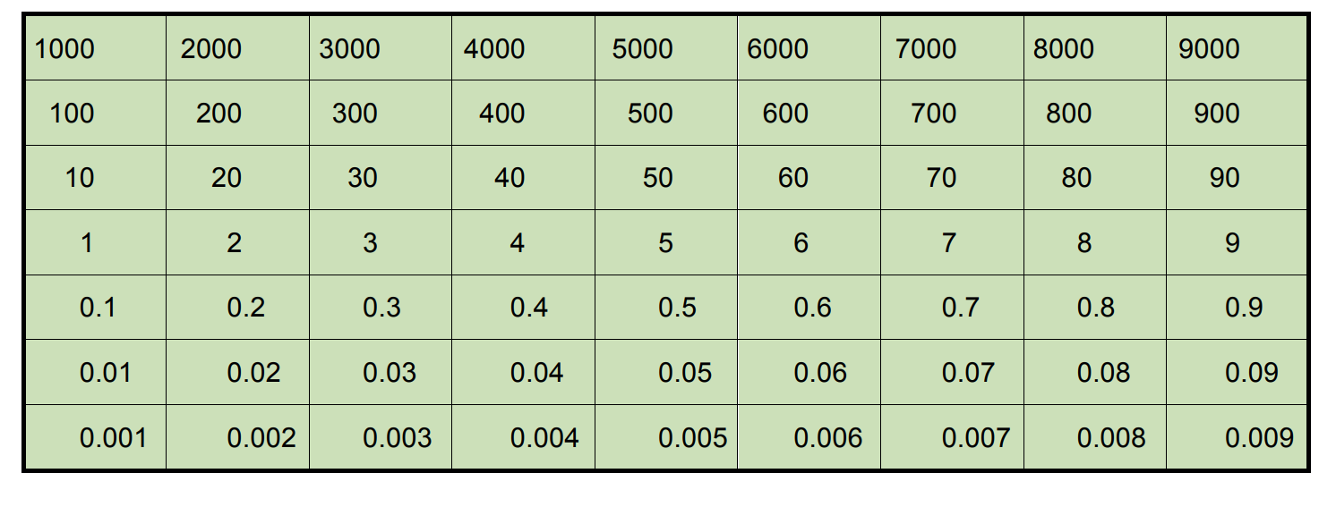
Place value chart
We note that the current non-statutory guidance for the primary curriculum does not mention place value as an explicit ‘topic’ but embeds the relevant issues within learners’ understanding of quantity, notation, numberline, decimals and measurement. In the approach taken in the concept-pedagogy table we work the other way round unpacking the components of understanding when people talk about ‘place value’.
The problems that novice teachers, children and possibly parents all have with place value are the same; adults may mask these with shortcuts or rule following. Secondary teachers might be fluent themselves with place value but novices in all key stages have to understand that there are issues that are generally problematic for learners even in KS3, especially decimals.
Note that Dienes base-ten apparatus can be used for decimals as well as whole numbers and even strong mathematicians can find this experience enlightening from a pedagogic perspective.
The following might also be helpful and the presence of a mentor is not essential. Ask novices to work through tasks suggested after the Place Value chart below as learner and then as teacher; or role play between mentor and novice. This comes from Mathematical Imagery but is also widely recommended for use in the non-statutory guidance – search for ‘Gattegno chart’.

Slide 62
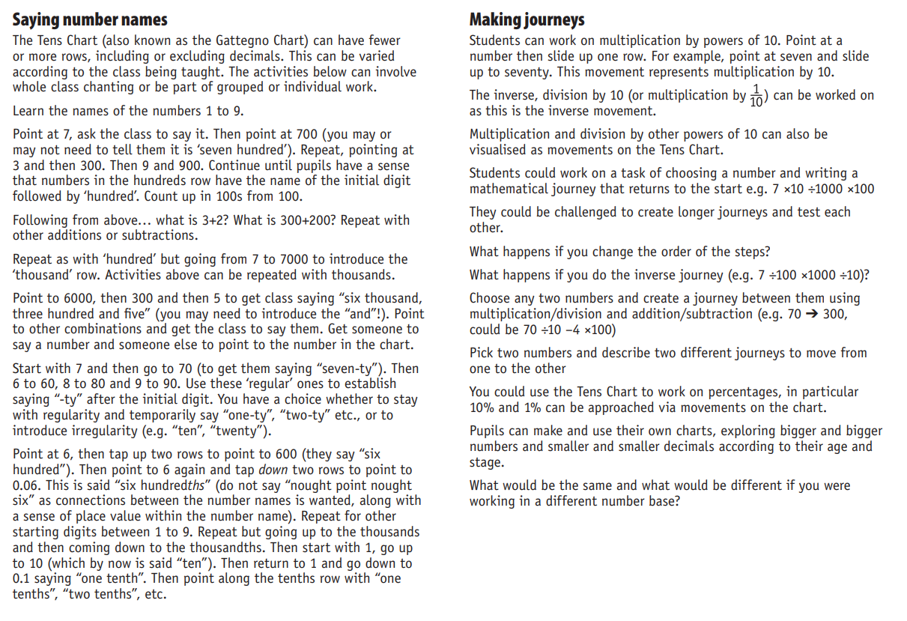
Using the place value chart

Slide 63
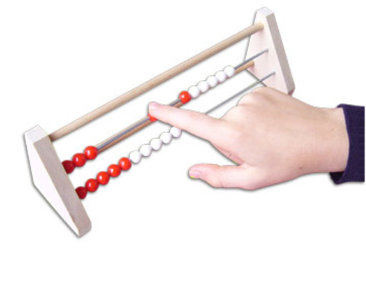
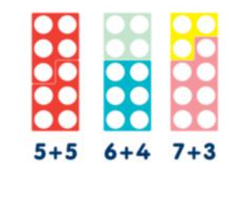
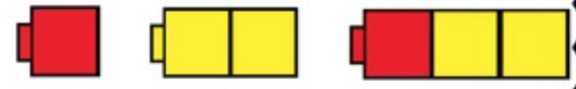
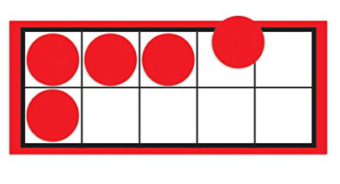
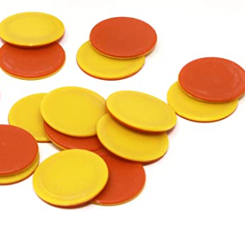
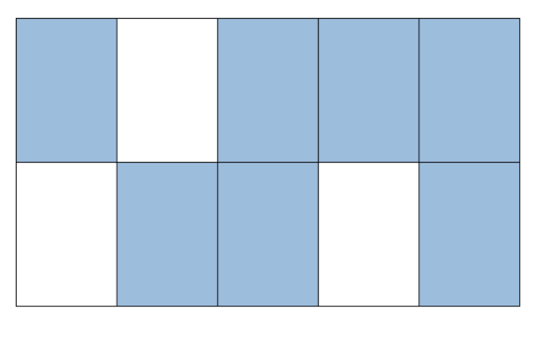
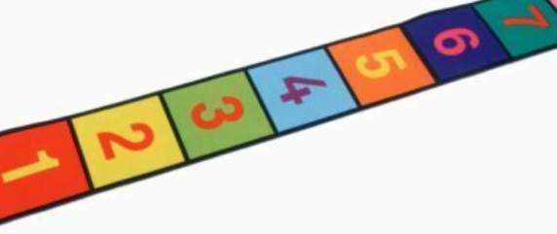
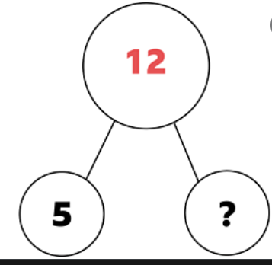
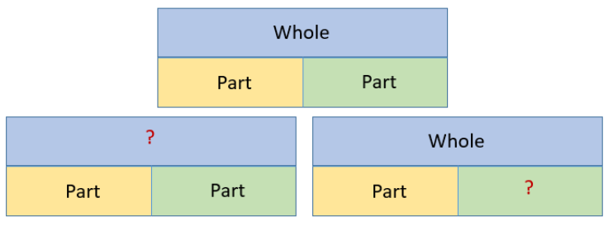
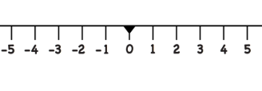
Part-whole manipulatives and images used frequently in primary mathematics, including illustration of part-part-whole (a = b + c) relations

Slide 64
Part-part-whole models of additive relations
Secondary novices might not have come across the use of part-part-whole models used in primary as models of additive relations.
Mathematical idea to be experienced | Notes about the idea | Possible images | Language | With novices | Issues
Part-part-whole/ additive relationship | This idea introduces the additive relationship, addition, subtraction, partition, missing number and associated actions over time and continues to appear throughout school mathematics. | Physical materials Partly-shaded shapes Cherry model Two-sided counters Numicon Bar model Numberline Rekenrek | Part-part-whole Adding Subtracting Difference | Compare the use of different images to represent part-part-whole so that the particular image that arises from each can be understood. This is valuable even for secondary novices so they understand what learners may have experienced and heard. | What is the whole? Simultaneous questions about addition and subtraction. Eventual shift to using a directional numberline.

Slide 65
Angle sorting task
In this task the novice is given a collection of possible conceptualisations, some from everyday use and others from mathematical experience, and asked to sort them in whatever way they choose. We use ‘angle’ as an example. Sorting may differ according to the age group being considered. The mauve phrases can be removed for primary novices.
Angle is a notoriously difficult concept to define - it is turn, pointiness, the gap between two rays etc.
The collection of meanings we use comes from research and experience about learners’ ways of understanding angle that they have developed from everyday life and from their earlier mathematical learning. Participants can also add ideas of their own. It is important for new teachers to understand that learners will have constructed their own meanings from multiple experiences and, whereas teachers have one concept that suits most of these conceptualisations, learners are likely to have many conceptualisations that ‘feel’ as if they are different things. This kind of sorting task brings to the fore the differences that new learners perceive and that teachers have forgotten from their own past. Mentors can construct such sorting tasks themselves from their own experience, from colleagues, and from asking their own learners what they understand by particular words.
A useful source can be found in this booklet, published by the Open University, and now openly available <link>

Slide 66
Angle sorting task
Pointiness | Space (distance or area) between two lines
Sharpness | Relationship between two lines or two directions
Turn | What fits between two non-parallel lines
Bends | Going round corners
Spinning self or objects | Difference of slope between two lines
Characteristic of a shape | Place where two lines meet/cross
Bearing | How far two lines are open/closed
Direction relative to something else | Amount of divergence
Time on a clock | The argument of a function
Why | Steepness
Rotation | Gradient
Measurement in degrees | Smaller or larger angles
Vertex | 'it goes at an angle'
A. Discuss the criteria they used to sort them:
  ‘what are the connections between these?’
  ‘what is different about these?’
  ‘is there another way to sort them?’.
To map the gap between what learners already know and what they are expected to learn, a helpful way to sort would be to identify:
Everyday meanings Previously learnt meanings Mathematically useful meanings Meanings that need more precision

Slide 67
Angle sorting task
Notes for working with secondary novices on the way knowledge of angles relates to trigonometry and the use of radian measure
Mathematical idea to be experienced | Notes about the idea | Possible images | Language | With novices | Issues
Unit circle | Trigonometric ratios in triangles generated by radii in unit circles show how these ratios vary with angle. | A unit circle of radius one unit, which, when rotated, generates right angled triangles whose distances from the axes are the sine and cosine of the anti-clockwise angle of rotation from the horizontal. Tangent is given by the gradient of the radius. Graphs of sine, cosine and tan can be generated using dynamic geometry with the angle as the independent variable. Tangent can be given by the gradient of the radius, or the length of the tangent from circumference to the horizontal axis. | The concept of defining an angle by these ratios does not require the words opposite, adjacent , hypotenuse until the ratios come to be applied beyond the unit circle image, i.e. trig ratios can be introduced as descriptions of angles rather than by having to learn new words for parts of triangles. | Many novices will have ‘SOHCAHTOA’ as their ‘go to’ basis knowledge for triangles. Work with the unit circle can be led by posing the sort of questions that are about the variation and invariance of the ratios depending on the angle, rather than questions that entail resolving right-angled triangles. This approaches trigonometry from a different direction and hence enriches the conceptual connections. | Unit circles also give radian measure of angle as arc length on the circumference, and also show, by scaling, how ratio is invariant for other triangles (scaling the radius). They make sense of trig ratios for non-acute angles, and directly generate trig functions, so that solving right-angled triangles is seen as a limited subset of the uses for the ratios.

Slide 68
Concept study by comparing resources
Rather than diving into lesson planning, some time spent analysing a concept is worthwhile. Reasons for doing this well before teaching a topic include: exposing the novice’s own knowledge; experiencing the need to unpack knowledge and identify the micro-concepts that contribute to robust and flexible understanding; exposing a variety of possible approaches to an idea; introduction to the ways in which professional teachers, textbook writers and resource designers think about mathematical concepts.
There is no ‘light’ version of this task as it would be too superficial to make any sense. Start by asking novices to draw a mind-map of their own about a relevant concept and pose some subject specific questions about it:
  What assumptions do you make about previous experience, and how does it connect?
  What does this concept contribute to future mathematical learning?
  What are the associated underlying meanings
  What is interesting about this concept?
  What starting example would you use and why?
  What similar non-examples might you introduce?
  What representations would you use and in what order?
It is important for new teachers to understand that learners will have constructed their own meanings from multiple experiences and, whereas teachers may have one embracing concept that suits most of these conceptualisations, learners are likely to have many conceptualisations that ‘feel’ as if they are different things.

Slide 69
Concept study by comparing resources
Then:
Collect examples from several textbooks/ online resources/ school-based materials etc. that aim to ‘teach’ a concept and compare them: | Collect examples from several textbooks/ online resources/ school-based materials etc. that aim to ‘teach’ a concept and compare them:
 | Use of images Use of language Choice and layout of examples, worked examples, questions etc. Choice of contexts Imagine what the intended conceptual steps might be from these considerations
This can work well if you compare an older textbook, particularly one they may have used when they were at school, to more recent textbooks or resource banks, such as one of the websites that focus on different versions of mastery.
In the discussions that follow it is likely that the mind-maps will be extended and become more complex, although the discussion will always go in directions that depend on novice knowledge and perspectives. Here are some possible further questions:
  Cluster similar ideas together – maybe in a new map
  How do these different clusters relate past and future learning?
  Is there one conceptual idea that encapsulates measurement across the whole of mathematics?
  What are the implications for teaching measurement?
In the following video Brent Davis describes 5 layers of the task of ‘concept study’. Note that he is talking about a sustained process with several teachers across key stages rather than the one-to-one conversations you might be having with novice teachers. Nevertheless, this video is worth watching as it shows the importance of doing some fundamental thinking about concepts as they might appear to learners.
http://www.birs.ca/events/2015/5-day-workshops/15w5151/videos/watch/201508310930-Davis.html.

Slide 70
Multiplication sort cards (for editable version go here)
3 lots of 12 | 12 lots of 3
3 times 12 | 12 times 3
3 multiplied by 12 | 12 multiplied by 3

Slide 71
12, 3 times | 3, 12 times
3 (12) | 12 (3)
3 x 12 | 12 x 3

Slide 72
3 times as much as 12 | 12 times as much as 3
Product of 3 and 12 | Product of 12 and 3
3 by 12 | 12 by 3

Slide 73
3 groups of 12 | 12 groups of 3
3⋅12 | 12⋅3

Slide 74
Repeated addition | Allocation or rate
Array or area | Scale factor
Cartesian product

Slide 75
Cakes come in 3 different sizes and any one of 12 different flavours. How many different choices are there?
A cake has 3 chocolate buttons on top. If I have 12 cakes, how many buttons do I have? | A shop sells 12 types of cake. I buy 3 of each type, how many cakes do I buy?
Cakes are arranged on a rectangular plate in 3 rows and 12 columns. How many cakes are there on a plate? | Louise has 12 cakes. Jo has 3 times as many. How many cakes does Jo have?

Slide 79
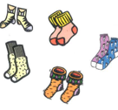
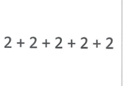
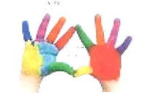
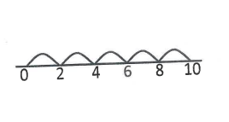
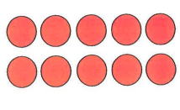
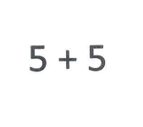
Sorting and discussion cards for 2 x 5 = 10

